Slide 1


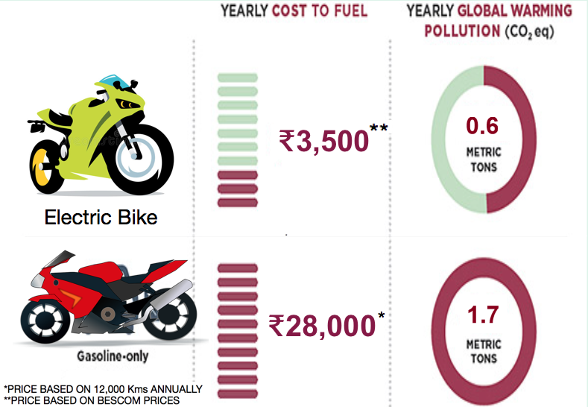
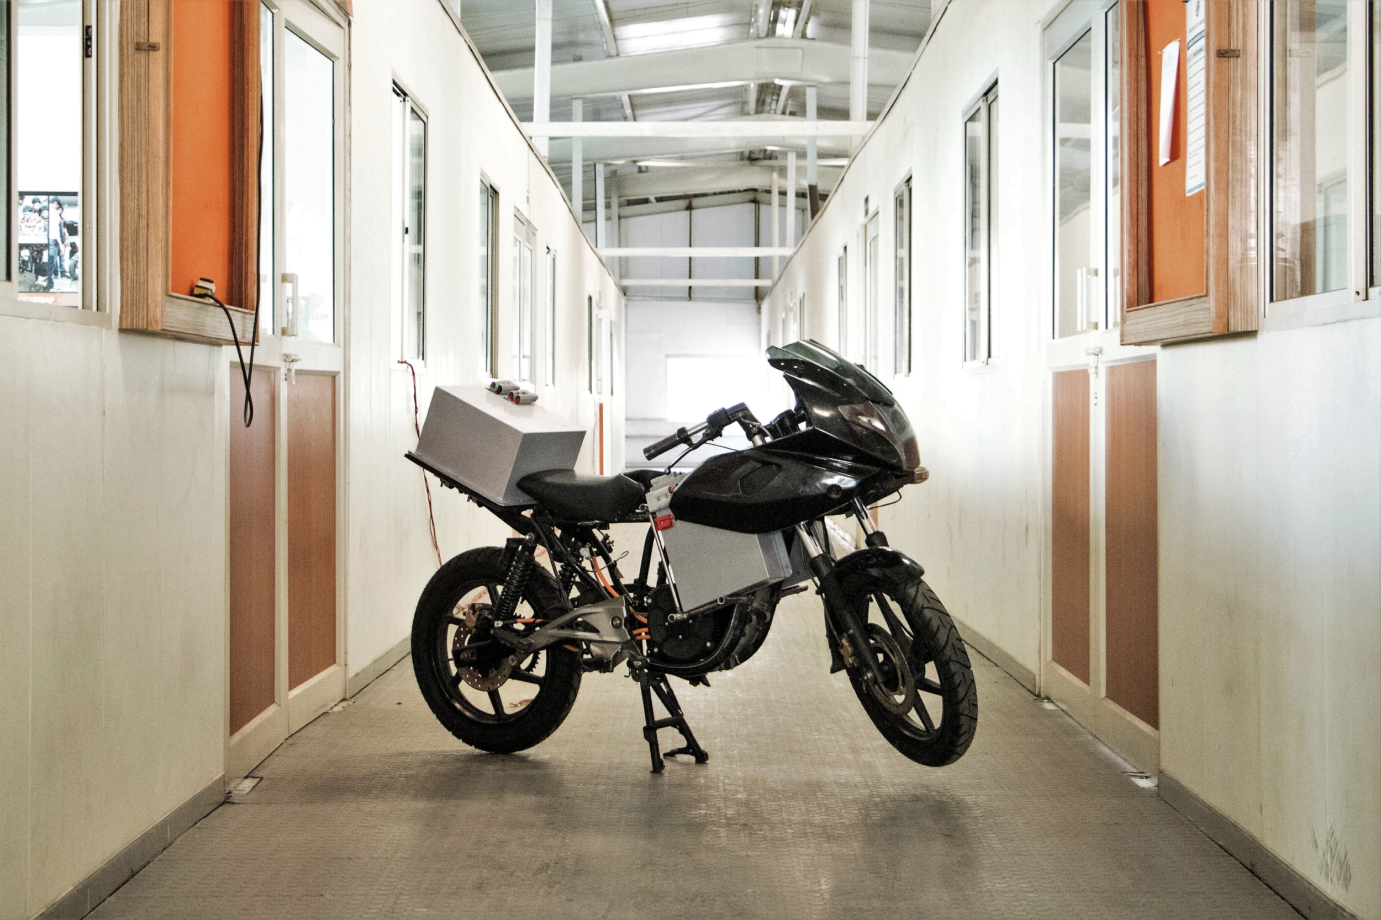
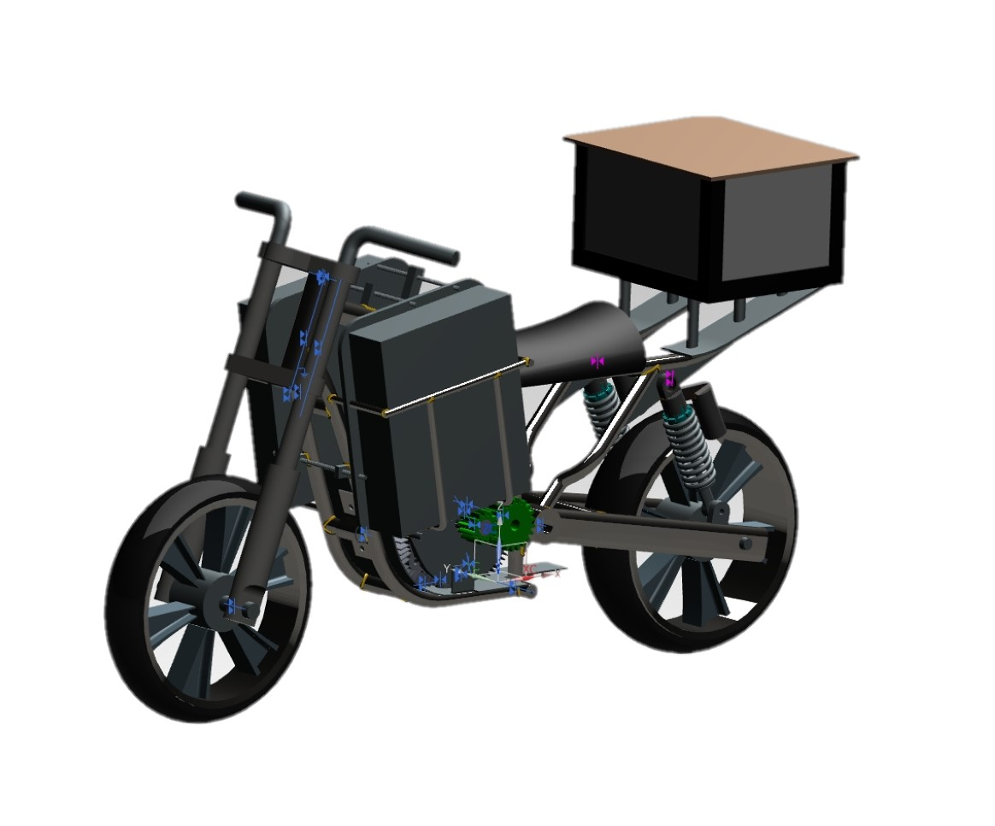
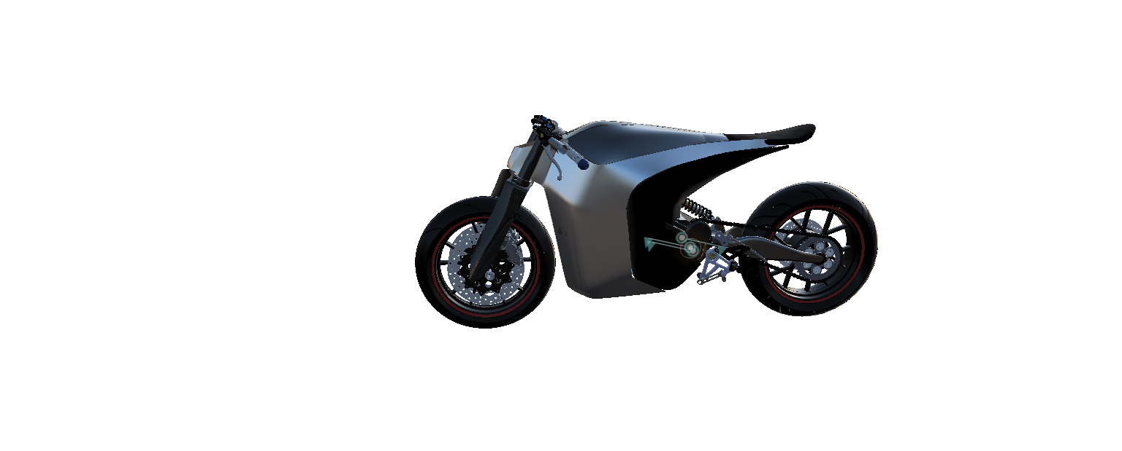
Vision X
Problem Addressed
Business Plan
Transportation and Climate Change :
Burning fossil fuels releases greenhouse gases, which cause the Earth’s atmosphere to warm, resulting in changes to the climate.
Vision X would like to address the problem of carbon emission in the transportation domain by building an economical, high performance electric motorbike which:
Performs at par or better than competing petrol based bikes
Changes the public perception of EVs
Provides low cost last mile connectivity
Significantly reduces Carbon footprint
We will build an electric motorcycle which is as powerful as a 200cc IC engine bike, which will prove to the public that EVs can be more powerful than ICE vehicles.
We will appeal to the niche market with a high price, performance bike, gain publicity and desirability and then target the mass market (lower price and performance variants).
We intend to develop a charging infrastructure through public private partnerships(PPP) .
Voice of Prospective Customers
“ The rider in me says, Riding is all about passion so it doesn't matter what my bike runs on. The human being in me says, I’d prefer a green alternative to any bike. To sum it up, I’d prefer an electric bike over a petrol driven one. Of course the present scenario is against electric bikes but we’re here today in a technologically advanced world only cause we worked towards it. ” - Vinay Ratnam, PES University
“It is a good alternative ,provided it can match the performance and pricing of an equivalent petrol bike.” - Lalith Kumar, RNS Institute of Technology
“Electric motorcycles have a huge scope in India as it is the best solution for last mile connectivity. If there is a chance of revolution in the transportation domain it most probably will be in the electric motorcycle domain” - Vishal Baasha, NIT Surathkal
“ The truth is, there’s a lot to know in order to really enjoy riding a bike – and to me, enjoying riding a bike is to not have to think about how or on what it's running.Given that electric bikes have instantaneous torque and also an added green tick, there’s no looking back as to why it wouldn't be my choice of riding.” - Pratyush Singh, BITS Pilani Hyderabad Campus
The Solution
To build an end-to-end solution for sustainable transport.
To build a high performance, cost effective electric bike.
To enhance the riding experience we will
* collect usage data to improve performance
* provide OTA updates for better performance and
maintenance of the vehicle
Carbon Zero Challenge
Last summer our team entered a competition called Carbon Zero Challenge hosted by IIT Madras in search of an up and coming project to help reduce the dangerous carbon content in our atmosphere. Our team after rounds of tests and interviews came into the top 25 teams out of 530+ teams! We were awarded 5 lakh rupees and fine mentorship from a renowned MIT professor to put together the Bike and showcase it in the final round of the competition this February worth 25
Specification | Pulsar 220F | Competing e-bike | Vision X prototype
Top speed (kmph) | 120 | 100 | 120
Mode of propulsion | Internal combustion engine | Electric Motor | Electric Motor
Power | 15.3kW | 10kW | 22kW
Torque | 18.55 Nm | 27 Nm | 60 Nm
Range/Mileage | 40 kmpl | 100 km @ 35 kmph | 150* km @ 40 kmph
Cost per km (₹/km) | 2.34 | 0.30 | 0.30
Energy expenditure per km (Wh/km) | 394 | 180 | 187
Carbon Footprint (g/MJ) | 28.29 | 15.52 | 16.06
Maintenance (₹/year) | ~4500 | <2000 | <2000
Next Steps after CZC
Design and finalise prototype
Homologation
Pilot production
Market research
Charging Infrastructure
Prototype Alpha
(without body)
*20% - 80% charge
Final build

